Slide 1
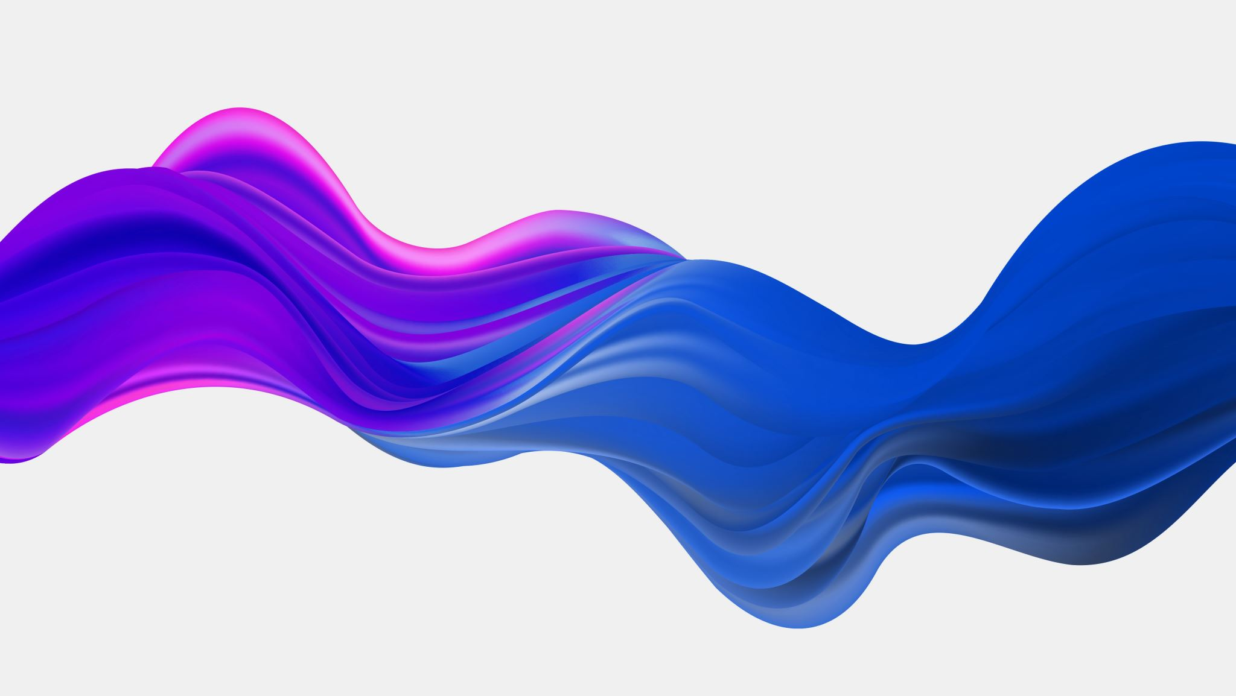
UWEBIC IY425
Electrical and Electronic Engineering Principles 2
Capacitors: Quiz
Mohammad Hosseinabady
Monday 24-Jan-2022
mohammad.hosseinabady@kaplan.com

Slide 2
1. The basic capacitor is made up of ___ that separates two conductive plates.
a. a conductor b. a spacer c. a dielectric d. an electrode
Answer: c

Slide 3
5. A capacitor takes ___ time constants to charge to 95% of its capacity.
a. 2 b. 3 c. 4 d. 5
Answer: b

Slide 4
6. The rate of charge or discharge of a capacitor is based on ___ function.
a. an exponential b. a linear c. a parabolic d. a trigonometric
Answer: a

Slide 5
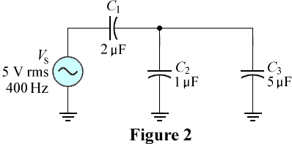
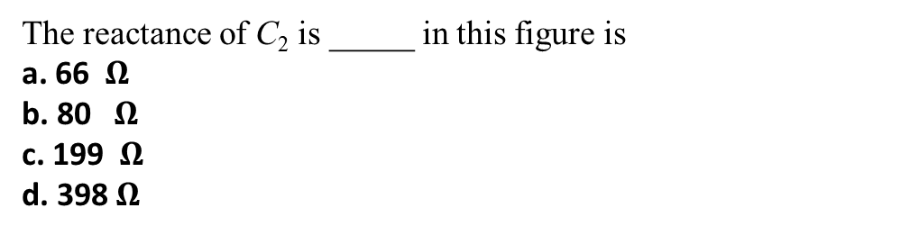
The reactance of C₂ is _____ in this figure is
a. 66 $Ω$
b. 80 $Ω$
c. 199 $Ω$
d. 398 $Ω$
Answer: d

Slide 6
The total circuit reactance is ___ in this figure is
a. 50
b. 140
c. 265
d. 676
Answer: c

Slide 7
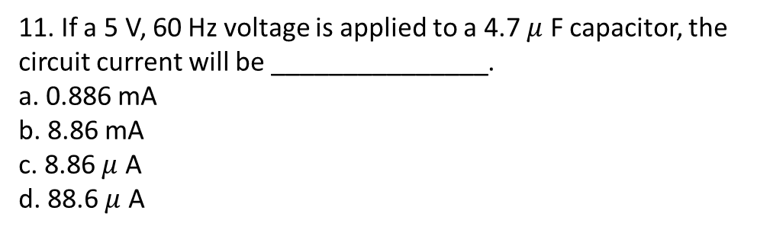
11. If a 5 V, 60 Hz voltage is applied to a 4.7 $μ$ F capacitor, the circuit current will be _______________.
a. 0.886 mA
b. 8.86 mA
c. 8.86 $μ$ A
d. 88.6 $μ$ A
Answer: b

Slide 8
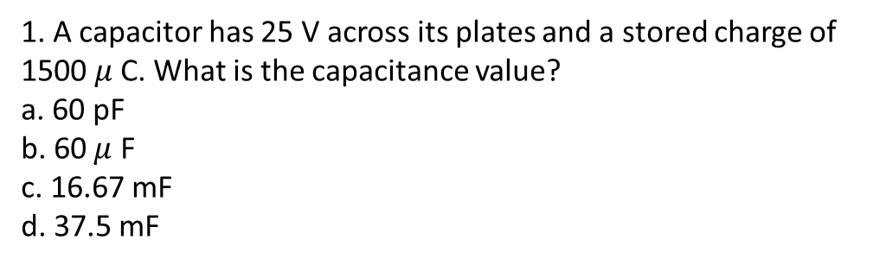
1. A capacitor has 25 V across its plates and a stored charge of 1500 $μ$ C. What is the capacitance value?
a. 60 pF
b. 60 $μ$ F
c. 16.67 mF
d. 37.5 mF
Answer: b

Slide 9
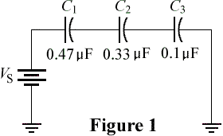
What is the capacitance of this circuit ?
Answer: a

Slide 10
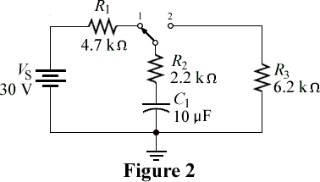
How long would it take the capacitor in this figure to completely charge if the switch was in position 1?
a. 22 ms b. 69 ms c. 345 ms d. 440 ms
Answer: c

